Slide 1

Sentiment analysis of customer feedback for commercial & mobile bank using machine learning method
Presented By
Md. Ashaful Azim
CSE 01606587
CSE 16th Day A
Department of CSE
Supervised By
Mrs. Taofica Amrine
Sr. Lecturer & Chairman
Department of CSE,
Port City International University

Slide 2
Contents
Introduction
Objectives
Motivation
Literature review
Methodology
6. Required Tools & Technology
7. Dataset
8. Data Preprocessing
9. Result & Performance Analysis
10. Conclusion & Future Works
11. References

Slide 3
Introduction
The categorized bank customer opinions are classified through machine learning for analyzing the sentiment of the people.
01

Slide 4

Objectives
Identifying the customer segmentation for provide better customer supports.
Increase company revenue.
02

Slide 5
Motivation
Global financial bank finding much more technologies to process unstructured data.
Help banks to cope with processes that require.
03

Slide 6
Literature review
Title & Author | Publisher & Date | Summery
Title: Social Media Analysis for Investigating Consumer Sentiment on Mobile Banking Authors: Alessandra Giovanna Asali | Association of International Business and Professional Management(AIBPM), Indonesia , 16 November 2021 | Dataset: Collect from twitter (January 1st, 2019 until December 31st, 2020) Algorithms: Neural network model, Naive bayes Result/Accuracy: NNM (79.8%),NV(57.5%) Limitations: Collected data for limited time and available range .
Title: A Review of Social Media Posts from UniCredit Bank in Europe: A Sentiment Analysis Approach Authors: Raphael Kwaku Botchway , Abdul Bashiru Jibril | Association for Computing Machinery, New York, NY, United States 12 September 2019 | Dataset: Use own data set which collected from social media by API Algorithm: Valence Aware Dictionary and sentiment Reasoner. Result/Accuracy: 71%.
04

Slide 7
Literature review (Cont.)
Title & Author | Publisher & Date | Summery
Title: An emotion-based segmentation of bank service customers Authors: Cristina Calvo-Porral and Jean-Pierre Lévy- Mangin | Emerald Publishing Limited. United Kingdom 7 September 2020 | Dataset: Feom 451 bank service customers. Algorithms: IJBM, Result/Accuracy: 0.610 Limitations: Low range data of data source , also accuracy is relatively low.
Title: Digitalization and Big Data Mining in Banking (Review) Authors: Hossein Hassani , Xu Huang and Emmanuel Silva | MDPI , Switzerland, 20 July 2018 | Dataset: Data Mining applications in banking since 2013 Algorithm: A research framework for Data Mining applications in banking. Result/Accuracy: Show percentage on data mining applications fact .
05

Slide 8
Literature review (Cont.)
Title | Publisher & Date | Summery
Title: Intelligent Vector-based Customer Segmentation in the Banking Industry Authors : Salman Mousaeirad | Cornell University, 22 Dec 2020 | Dataset: Contains the banking and non-banking numeric features of customers Algorithm: Customer2Vec Model, Versus Word2Vec Result/Accuracy: Proposed Method = 0.959 Limitations: Embedding vector for each customer not include dynamic visualized customer
Title: Data Mining in Banking Sector Using Weighted Decision Jungle Method. Authors: Derya Birant | IntechOpen 20 April 2020 | Dataset: Used 17 real-world banking datasets Algorithms: Class-based weighting mechanism, Decision jungle. Result/Accuracy: Decision jungle 91.18, Class-based weighted decision jungle : 91.25 Limitations: This methods failed to classify macro-averaged recall values.
06

Slide 9
Methodology
Applying Algorithms
Train(70%)
Multinomial NB
KNN
Bank customers data
Feature Extraction
Bag-of-words
Test(30%)
Trained Model
Data Preprocessing
Remove URL, Hashtags, Emoji,
Numbers ,Stemming
Result
Unstructured Data
Stop Words Removal
07

Slide 10


Required Tools & Technology
Google Colab
Python
08

Slide 11
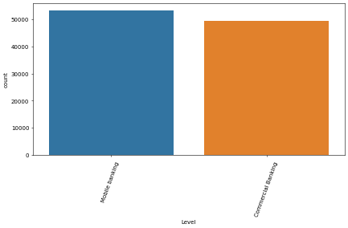
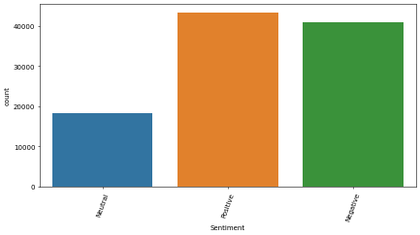
Dataset
In this section, I gathered (101883) compliment data for mobile and commercial bank. Where 63168 of data personally scraped, and the remaining 39191 data were gathered from the Consumer Financial Protection Bureau (CFPB).
09

Slide 12
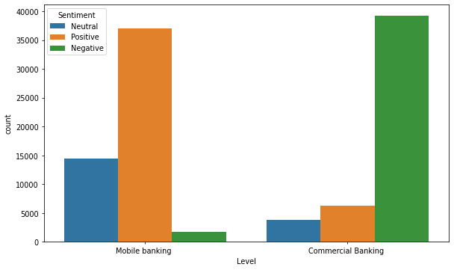
Data visualization
10

Slide 13
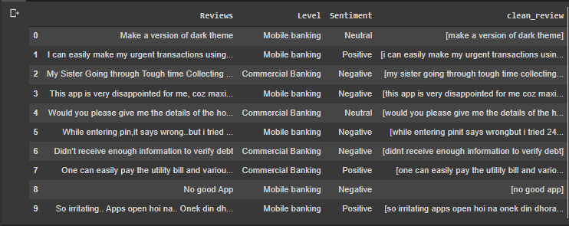
Data Preprocessing
Changes are displayed after pre-processing.
11

Slide 14
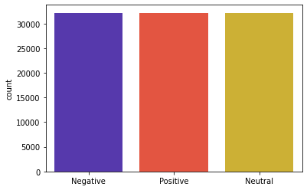
Oversampling
Random oversampling involves randomly selecting examples from the minority class, with replacement, and adding them to the training dataset.
12

Slide 15
Feature Extraction
Bag-of-words
A bag-of-words is a representation of text that describes the occurrence of words within a document. It involves two things:
A vocabulary of known words.
A measure of the presence of known words.
13

Slide 16
Algorithms
Multinomial Naive Bayes
Multinomial Naive Bayes algorithm is a probabilistic learning method that is mostly used in Natural Language Processing (NLP)..
P(B|A).P(A)
P(A|B) =
P(B)
14

Slide 17
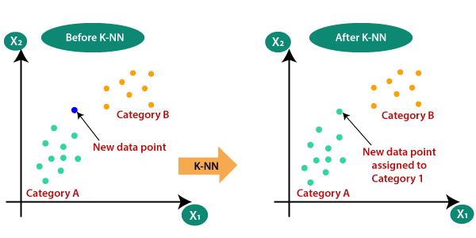
Algorithms (Cont.)
KNN
K-Nearest Neighbours is a supervised machine learning algorithm. The algorithm can be used to solve both classification and regression problem statements.
15

Slide 18
Result & Performance Analysis
Score | Algorithms
 | Multinomial NB | KNN
Precision | 0.87 | 0.91
Recall | 0.86 | 0.91
F1-score | 0.85 | 0.91
Accuracy | 0.86 | 0.91
16

Slide 19
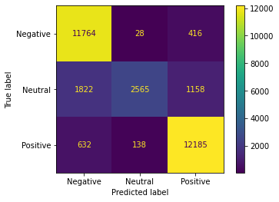
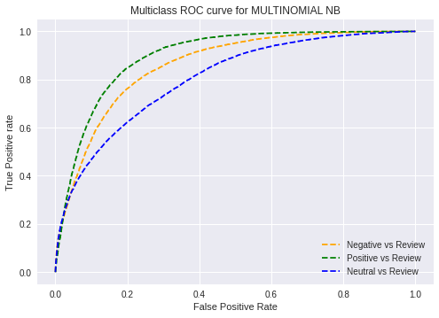
Multinomial Naive Bayes
The Confusion Matrix (CM) and the ROC (Receiver Operating Characteristic) curve of Multinomial Naive Bayes are shown in Figure.
17

Slide 20
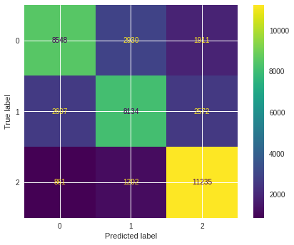
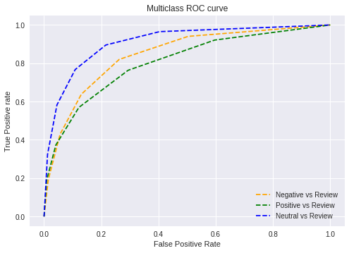
KNN
The Confusion Matrix (CM) and the ROC (Receiver Operating Characteristic) curve of KNN classifiers are shown in Fig.
18

Slide 21
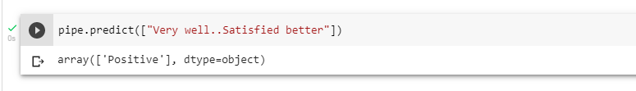
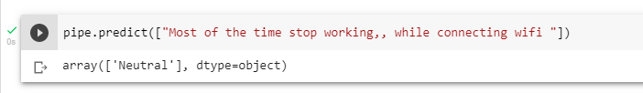
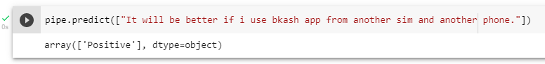
Experimental Input & Output
19

Slide 22
Comparative Analysis
20

Slide 23
Conclusion & Future Works
The goal is to achieve customers satisfaction also reduce costs. The bank company could take some steps for the betterment .
Large number of non-English compliment was a limitation to the study. Think that these sentiment could potentially provide interesting insights that can be exploited for future work.
21

Slide 24
References
An emotion-based segmentation of bank service customers || Cristina Calvo-Porral and || Jean-Pierre Lévy- Mangin || Emerald Publishing Limited || United Kingdom || September 2020
Digitalization and Big Data Mining in Banking (Review) || Hossein Hassani , Xu Huang and Emmanuel Silva || MDPI Switzerland || 20 July 2018
Intelligent Vector-based Customer Segmentation in the Banking Industry || Salman Mousaeirad || Cornell University || 22 Dec 2020
Data Mining in Banking Sector Using Weighted Decision Jungle Method. || Derya Birant || IntechOpen || 20 April 2020
A Review of Social Media Posts from UniCredit Bank in Europe: A Sentiment Analysis Approach || Raphael Kwaku Botchway, Abdul Bashiru Jibril || Association for Computing Machinery|| 12 September 2019
Social Media Analysis for Investigating Consumer Sentiment on Mobile Banking || Alessandra Giovanna Asali || Association for Computing Machinery || 12 September 2019
22

Slide 25
References
Analyzing user experience of mobile banking applications in Nigeria: A text mining approach || CBN Journal of Applied Statistics || June 2021
Sentiment Analysis and Topic Detection of Mobile Banking Application Review || IEEE Xplore ||24 December 2020
Slide template from slidesgo.com.
Dataset || Consumer Financial Protection Bureau (CFPB).
23

Slide 26
Thank You
24

